Slide 1
The morphological and anatomical structure of the stem

Slide 2
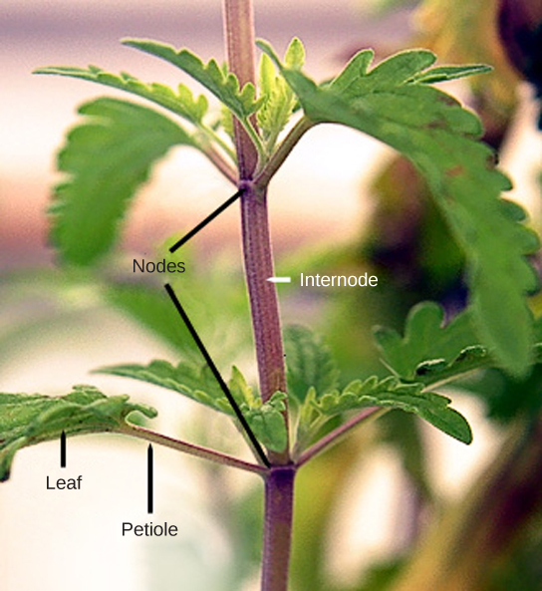
The morphological structure of the stem
Stems are a part of the shoot system of a plant. They may range in length from a few millimeters to hundreds of meters, and also vary in diameter, depending on the plant type. Stems are usually above ground, although the stems of some plants, such as the potato, also grow underground. Stems may be herbaceous (soft) or woody in nature.
A stem may be unbranched, like that of a palm tree, or it may be highly branched, like that of a magnolia tree. The stem of the plant connects the roots to the leaves, helping to transport absorbed water and minerals to different parts of the plant. It also helps to transport the products of photosynthesis, namely sugars, from the leaves to the rest of the plant.

Slide 3
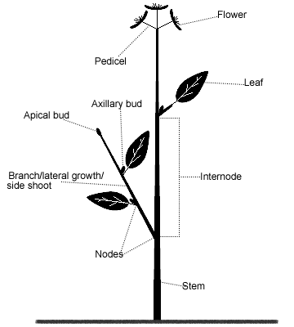
Nodes are points of attachment for leaves, aerial roots, and flowers. These parts of the stem contain a lot of cells which are called «meristematic»
The stem region between two nodes is called an internode.
The stalk that extends from the stem to the base of the leaf is the petiole.
An axillary bud is usually found in the axil—the area between the base of a leaf and the stem—where it can give rise to a branch or a flower.
The petiole is the stalk connecting the leaf to the stem.
The apex (tip) of the shoot contains the apical meristem within the apical bud.

Slide 4
The role of the stem is to:
provide support for the plant;
provide a place for leaves, flowers and fruit to grow;
keep leaves facing towards sunlight;
transport water and nutrients up from the roots and transport the products of photosynthesis down from the leaves;
store nutrients.

Slide 5
Stem Modifications
Some plant species have modified stems that are especially suited to a particular habitat and environment.
A rhizome is a modified stem that grows horizontally underground and has nodes and internodes. Vertical shoots may arise from the buds on the rhizome of some plants, such as ginger and ferns.
Corms are similar to rhizomes, except they are more rounded and fleshy (such as in gladiolus). Corms contain stored food that enables some plants to survive the winter.
Stolons are stems that run almost parallel to the ground, or just below the surface, and can give rise to new plants at the nodes.
Runners are a type of stolon that runs above the ground and produces new clone plants at nodes at varying intervals: strawberries are an example.
Tubers are modified stems that may store starch, as seen in the potato (Solanum sp.). Tubers arise as swollen ends of stolons, and contain many adventitious or unusual buds (familiar to us as the “eyes” on potatoes).
A bulb, which functions as an underground storage unit, is a modification of a stem that has the appearance of enlarged fleshy leaves emerging from the stem or surrounding the base of the stem, as seen in the iris.

Slide 6
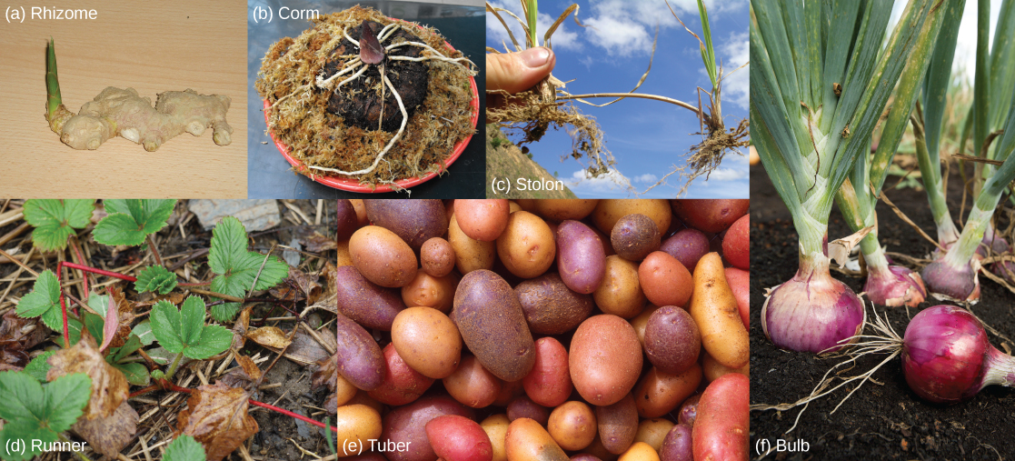
Stem modifications enable plants to thrive in a variety of environments. Shown are (a) ginger (Zingiber officinale) rhizomes, (b) a carrion flower (Amorphophallus titanum) corm (c) Rhodes grass (Chloris gayana) stolons, (d) strawberry (Fragaria ananassa) runners, (e) potato (Solanum tuberosum) tubers, and (f) red onion (Allium) bulbs.

Slide 7
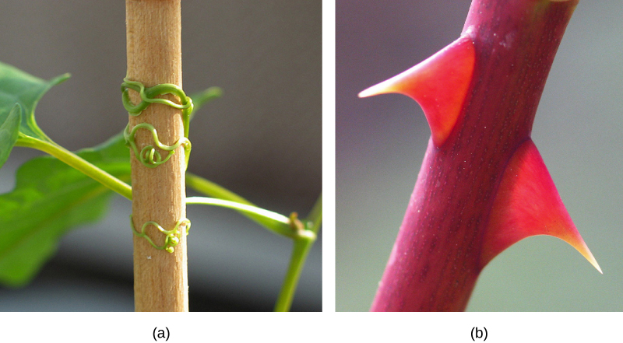
Some aerial modifications of stems are tendrils and thorns.
Tendrils are slender, twining strands that enable a plant (like a vine or pumpkin) to seek support by climbing on other surfaces.
Thorns are modified branches appearing as sharp outgrowths that protect the plant; common examples include roses, Osage orange and devil’s walking stick.
Found in southeastern United States, (a) buckwheat vine (Brunnichia ovata) is a weedy plant that climbs with the aid of tendrils. This one is shown climbing up a wooden stake. (b) Thorns are modified branches.

Slide 8
The anatomical structure of the stem
Primary Structure of Dicot Stem
In young dicotyledonous stems, there are three distinct regions – the epidermis, the cortex, and the stele.
These are described below:
Epidermis
The epidermis consists of a single layer of cells and is the outermost layer of the stem.
It contains stomata and produces various types of trichomes.
The outer walls are greatly thickened and heavy cutinized.
The cells are compactly arranged and do not possess intercellular spaces.
In transverse section, the cells appear almost rectangular.
Function
It serves mainly for restricting the rate of transpiration
It protects the underlying tissue from mechanical injury and from disease-producing organisms.

Slide 9
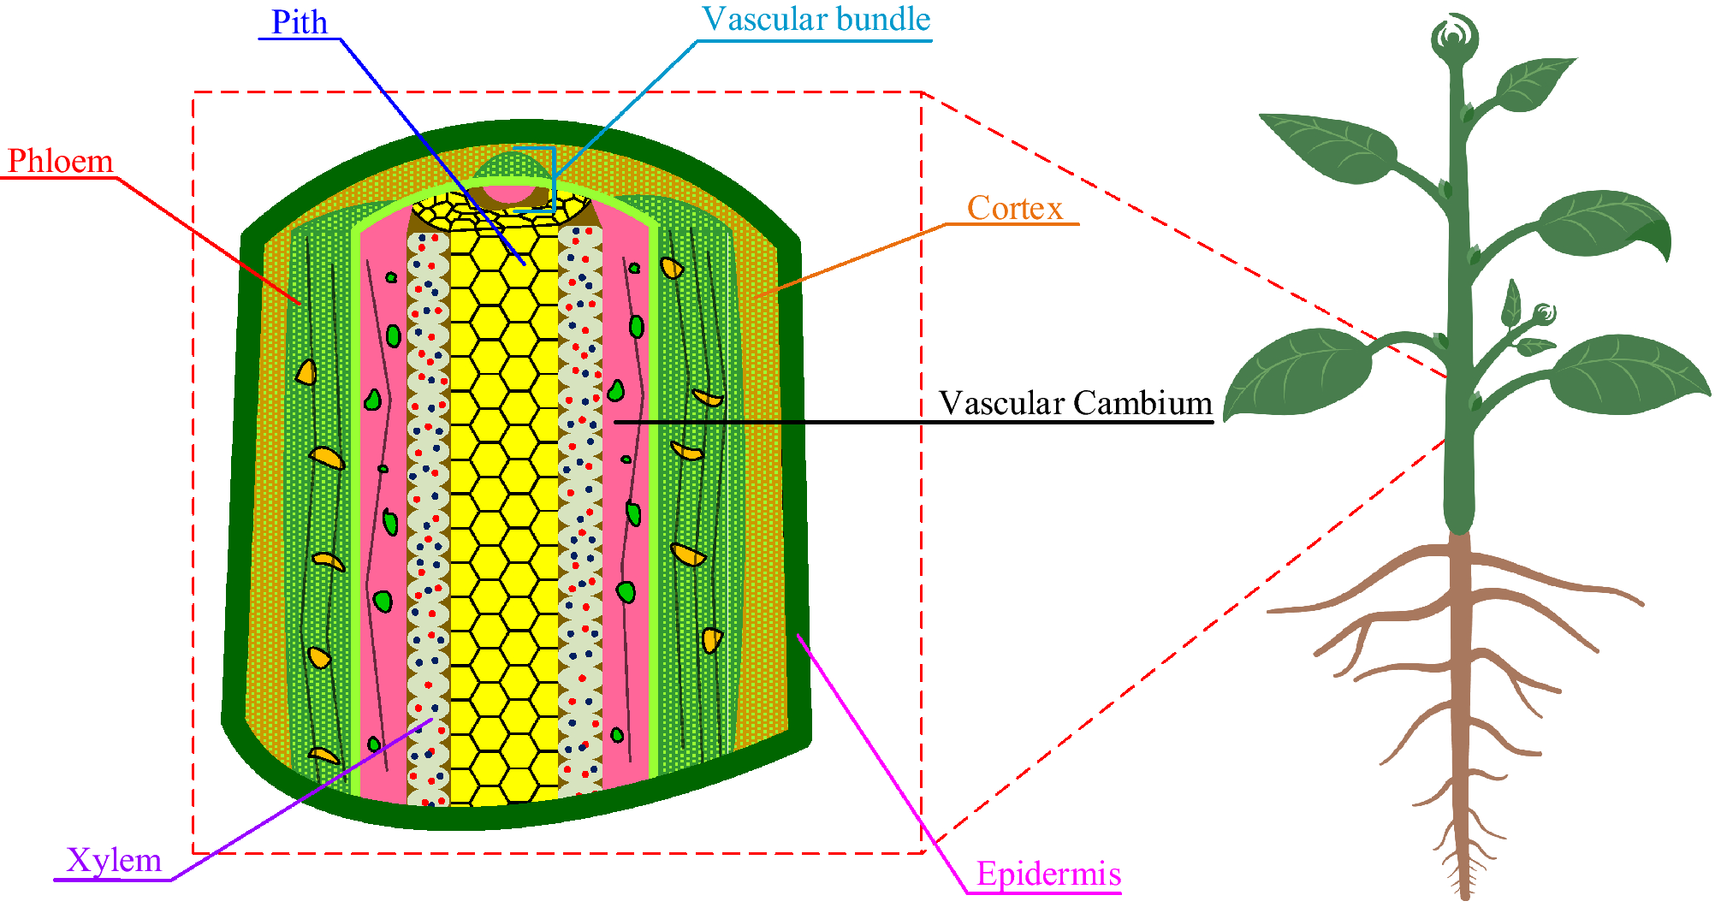

Slide 10
Cortex The region that lies next to the epidermis is the cortex. The innermost layer of the cortex is the endodermis, known also as the starch-sheath. It consists of a single layer of cells that surrounds the stele and contains numerous starch grains. Frequently it is most easily distinguishable from the surrounding tissue by the presence of these starch grains.
The part of the cortex situated between the epidermis and endodermis is generally divided into two regions:
An Outer zone of collenchyma cells.
An Inner zone of parenchyma cells.

Slide 11
Collenchyma
On the inside of the epidermis, there is usually band of collenchyma.
The cells of the collenchyma are modified parenchyma cells with cellulose walls thickened at the angles where three or more cells are in resembles parenchyma in being alive and in having a moderate amount of protoplasm.
Collenchyma cells of stem sometimes contain chloroplast.
Function
The chief function of collenchyma cells is to serve as strengthening material in succulent organs which do not develop much woody tissue, or in the soft young parts of woody plants before stronger tissues have been developed.
They are specially fitted for giving strength to young, growing organs, since the thickened parts of the walls have considerable rigidity, while the thinner parts allow for an exchange of materials between the cells and for the cells.
Collenchyma cells carry on photosynthesis when they contain chloroplasts.

Slide 12
Parenchyma
Parenchyma cells are generally regular in shape, have comparatively thin walls, and are not greatly elongated in any direction.
They are living cells and contain a moderate amount of protoplasm.
When they are exposed to light they develop chloroplasts and are known as chlorenchyma cells.
Chlorenchyma cells are thus only a special kind of parenchyma cells.
The parenchyma cells in the cortex of a stem are near enough to the light so that some or all of them develop chloroplasts and perform photosynthesis.
Function
The function of parenchyma cells is important in succulent stems and in the young parts of the stems and woody plants before strong mechanical tissues have been developed.
The parenchyma cells serve for the slow conduction of water and food.
In the case of cortex of stem, it becomes evident that the water which is received by the collenchyma and the epidermis must be conducted through the parenchyma.
The turgid parenchyma cells frequently help in rigidity to an organ.
The parenchyma is the special storage tissue of plants.

Slide 13
Sclerenchyma
Sclerenchyma cells are found in the cortex of some stems.
There are two varieties of these sclerenchyma cells
Short or irregularly shaped cells, known as stone cells
Sclerenchyma Fibres
Sclerenchyma fibres are long, thick-walled dead cells
Sclerids have been reported from the cortex of many water plants (e.g., Limnanthemum, Nymphaea, etc.).
Function
Sclerenchyma fibres serve as strengthening material.
Stone cells give stiffness to the cortex.

Slide 14
Endodermis
The innermost layer of the cortex is the endodermis consisting of barrel-shaped, elongated, compact cells, having no intercellular space among them.
Usually, the cells contain starch grains and thus the endodermis may be termed as starch sheath.
It surrounds stele.

Slide 15
Stele
The part of the stem inside of the cortex is known as the stele. The stele consists of three general regions:
Pericycle
Vascular bundle region
Pith
These three regions are described below:
1. Pericycle
The region between the vascular bundles and the cortex is known as the pericycle.
It is generally composed of parenchyma and sclerenchyma cells but sclerenchyma cells may be absent.
The sclerenchyma may occur as separate patches or as a continuous ring in the outer part of the pericycle, forming a sharp line of demarcation between the stele and the cortex.
The sclerenchyma cells in the pericyle are like other sclerenchyma cells in being long, thick-walled dead cells which serve as strengthing material.

Slide 16
2. Vascular Bundle
The vascular bundles as seen in cross-section, are arranged in the general form of a broken ring. Each vascular bundle consists of three parts.
Xylem • The nearest centre of the stem contained thick-walled cells and is known as xylem.
Phloem • The peripheral portion of the bundle is composed of thin-walled cells called phloem.
Cambium • The xylem and phloem are separated by a cambium layer, which is composed of meristematic cells.
The xylem which is formed before the activity of the cambium has begun to produce xylem and phloem cells is called primary xylem. It is composed of two parts:
Protoxylem
1. The xylem formed first is nearest the center of the stem is called protoxylem.
Metaxylem
2. The more peripheral part of primary xylem is known as metaxylem.

Slide 17
Vascular bundle: The part of the transport system that runs through the plant and carries water, minerals, and nutrition to different parts of the plant.
Different types of vascular bundles:
The vascular bundles are classified into three types accordingly as per the relative location of xylem and phloem:-
(1) Radial vascular bundle
(2) Conjoint vascular bundles
(3) Concentric vascular bundles

Slide 18
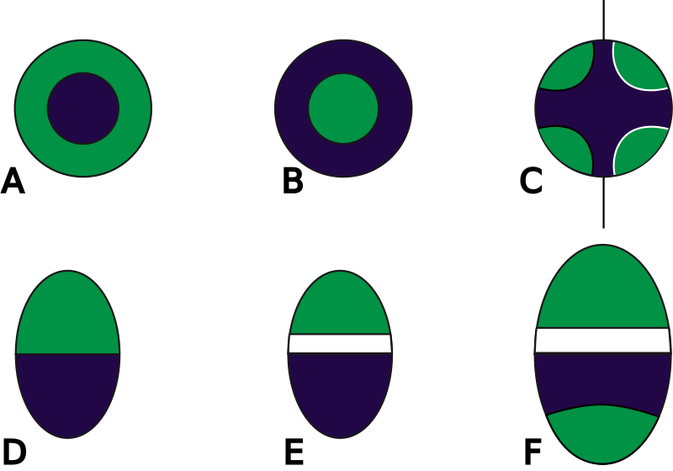
Blue – xylem
Green – phloem
White – cambium
A concentric, periphloematic B concentric, perixylematic
C radial with inner xylem, here with four xylem-poles, left closed, right open
D collateral closed E collateral open F bicollateral open

Slide 19
Pith Ray
The vascular bundles are separated from each other by radial rows of parenchyma cells known as pith rays.
The pith ray cells are usually elongated in a radial direction.
Function
They serve primarily for the conduction of food and water radially in the stem and for the storage of food.

Slide 20
Primary Structure of Monocot Stem
The monocotyledonous stems are similar to dicotyledonous stems in having an epidermis, a cortex and a stele.
The cortex may be well developed and sharply marked off from the stele or it may be quite narrow and inconspicuous.
It is the structure and arrangement of bundles that monocotyledonous stems, differ markedly from dicotyledonous stems.
Stele
Vascular bundles of monocotyledonous stems are usually scattered throughout the stele including the pith so that there is no distinction between pith and pith rays.
Sometimes the center of the stele is free from vascular bundles and is occupied by parenchyma cells which dry up and disappear at an early stage resulting in a hollow stem, as in most grasses.
Vascular Bundle
The vascular bundles of monocotyledonous stems are like those of dicotyledonous stems in consisting of xylem towards the centre of the stele and phloem towards the periphery.
The vascular bundles of monocotyledonous stem do not possess a cambium layer which is found in dicotyledonous stems. This means that monocotyledonous stems usually do not have secondary thickening.
Each bundle remains more or less completely surrounded by a sheath of sclerenchyma cells, the bundle sheath which is particularly well developed on the sides towards the centre and towards the periphery of the stem.
The phloem is made up mostly of sieve tubes, companion cells, and xylem of vessel and woody parenchyma.

Slide 21
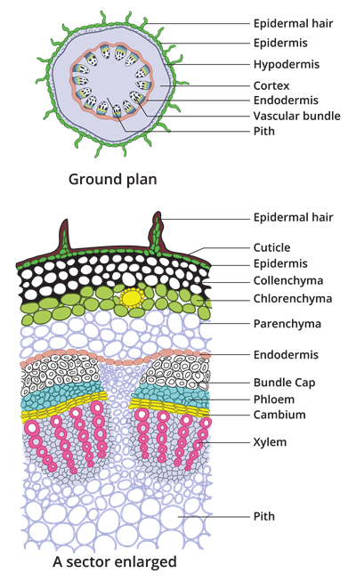
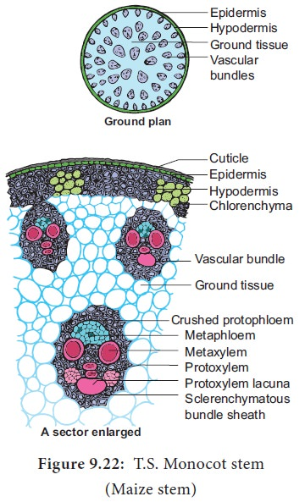
Monocot stem (Mayze)
Dicot stem (Sunflower)

Slide 22
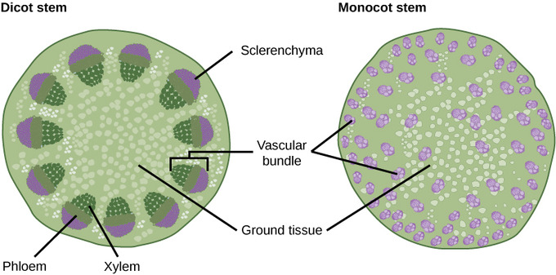
Vascular bundles: In (a) dicot stems, vascular bundles are arranged around the periphery of the ground tissue. The xylem tissue is located toward the interior of the vascular bundle; phloem is located toward the exterior. Sclerenchyma fibers cap the vascular bundles.
In (b) monocot stems, vascular bundles composed of xylem and phloem tissues are scattered throughout the ground tissue

Slide 23
Primary Growth
Most primary growth occurs at the apices, or tips, of stems and roots. Primary growth is a result of rapidly dividing cells in the apical meristems at the shoot tip and root tip. Subsequent cell elongation also contributes to primary growth. The growth of shoots and roots during primary growth enables plants to continuously seek water (roots) or sunlight (shoots).

Slide 24
Secondary grows
A process of formation of secondary tissues due to activity of vascular cambium and cork cambium for increasing thickness or girth or diameter of plant is termed as secondary growth.
Secondary growth begins right after the apical meristems have completed the primary growth process with all parts developed properly.
Secondary growth along with dicots happens with gymnosperms as well.
Secondary growth in the dicot stem involves the formation and functioning of the vascular cambium and cork cambium.
Secondary growth provides the plants or trees with protection against mechanical stress and microbial activity.
Secondary growth increases the girth of the stem.
In the case of woody plants, the major contribution is made by secondary tissues.
On the basis of the activities of vascular cambium and cork cambium, the process of secondary growth can be discussed under the following headings:
Activity of the vascular cambium
Activity of the cork-cambium

Slide 26
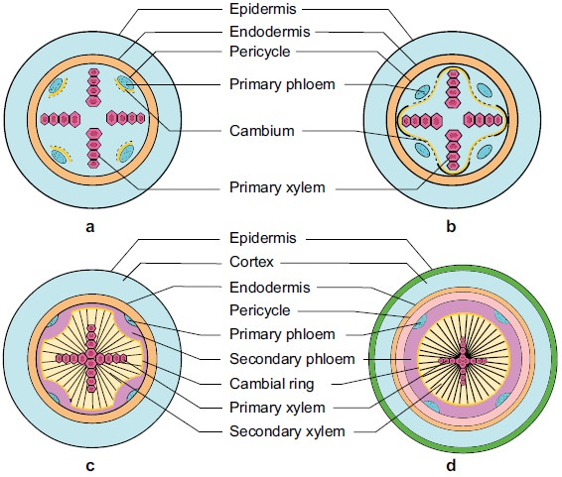
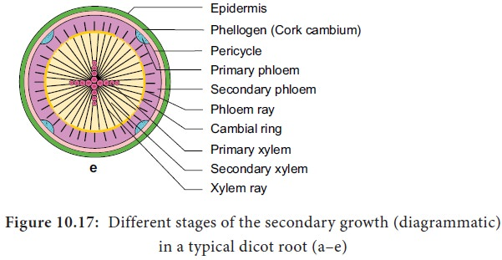

Slide 28
In woody plants, cork cambium is the outermost lateral meristem. It produces cork cells (bark) containing a waxy substance known as suberin that can repel water. The bark protects the plant against physical damage and helps reduce water loss. The cork cambium also produces a layer of cells known as phelloderm, which grows inward from the cambium. The cork cambium, cork cells, and phelloderm are collectively termed the periderm. The periderm substitutes for the epidermis in mature plants. In some plants, the periderm has many openings, known as lenticels, which allow the interior cells to exchange gases with the outside atmosphere. This supplies oxygen to the living and metabolically active cells of the cortex, xylem and phloem.

Slide 29
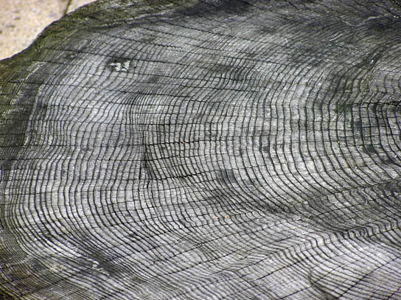
Annual Rings
The activity of the vascular cambium gives rise to annual growth rings. During the spring growing season, cells of the secondary xylem have a large internal diameter and their primary cell walls are not extensively thickened. This is known as early wood, or spring wood. During the fall season, the secondary xylem develops thickened cell walls, forming late wood, or autumn wood, which is denser than early wood. This alternation of early and late wood is due largely to a seasonal decrease in the number of vessel elements and a seasonal increase in the number of tracheids. It results in the formation of an annual ring, which can be seen as a circular ring in the cross section of the stem. An examination of the number of annual rings and their nature (such as their size and cell wall thickness) can reveal the age of the tree and the prevailing climatic conditions during each season.
The rate of wood growth increases in summer and decreases in winter, producing a characteristic ring for each year of growth.

Slide 30
The structure of the stem of Gymnosperms (Pinus sp.)

Slide 31
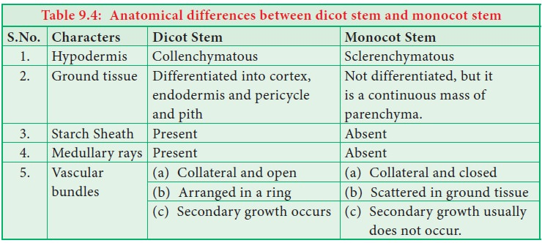
The differences between stem structure of Dicot and Monocots

Slide 32
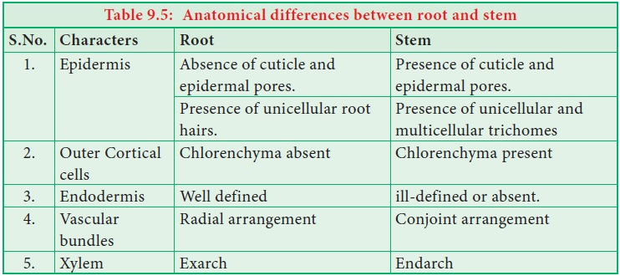
The differences between anatomical structure of stem and root
Endarch: In vascular bundle, endarch is the arrangement where protoxylem (older xylem) is inside and metaxylem (newly formed) is outside.
Exarch: When protoxylem is outside and metaxylem is inside, the arrangement is known as exarch.

Slide 33
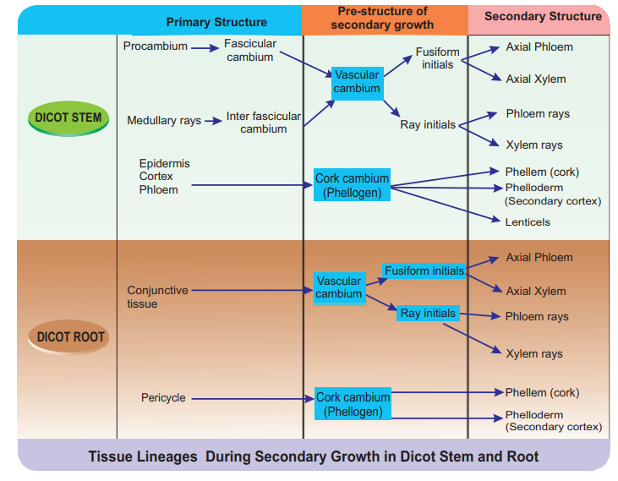

Slide 34
Key Points
The stem has three simple cell types: the parenchyma, collenchyma, and sclerenchyma cells that are responsible for metabolic functions, repairing and healing wounds, and storing starch.
The stem is composed of three tissue systems that include the epidermis, vascular, and ground tissues, all of which are made from the simple cell types..
The xylem and phloem carry water and nutrients up and down the length of the stem and are arranged in distinct strands called vascular bundles.
The epidermis is a single layer of cells that makes up the dermal tissue covering the stem and protecting the underlying tissue. Woody plants have an extra layer of protection on top of the epidermis made of cork cells known as bark.
The vascular tissue of the stem consists of the complex tissues xylem and phloem which carry water and nutrients up and down the length of the stem and are arranged in distinct strands called vascular bundles.
Ground tissue helps support the stem and is called pith when it is located towards the middle of the stem and called the cortex when it is between the vascular tissue and the epidermis.

Slide 35
Key Terms
collenchyma: a supporting ground tissue just under the surface of various leaf structures formed before vascular differentiation
sclerenchyma: a mechanical, supportive ground tissue in plants consisting of aggregates of cells having thick, often mineralized walls
sclereid: a reduced form of sclerenchyma cells with highly-thickened, lignified walls
lignin: a complex, non-carbohydrate, aromatic polymer present in all wood
stoma: a pore found in the leaf and stem epidermis used for gaseous exchange
trichome: a hair- or scale-like extension of the epidermis of a plant
xylem: a vascular tissue in land plants primarily responsible for the distribution of water and minerals taken up by the roots; also the primary component of wood
phloem: a vascular tissue in land plants primarily responsible for the distribution of sugars and nutrients manufactured in the shoot
tracheid: elongated cells in the xylem of vascular plants that serve in the transport of water and mineral salts
pith: the soft spongy substance in the center of the stems of many plants and trees
cortex: the tissue of a stem or root that lies inward from the epidermis, but exterior to the vascular tissue
parenchyma: the ground tissue making up most of the non-woody parts of a plant

